Slide 1
Smokeless Hose Cutting Process Improvement
20/02/2020

Slide 2
Problem Definition
Problem: Hazardous smoke during hose cutting
Cause: Lack of a specialized machine to cut and extract the smoke during cutting.
Impact :
Respiratory problems to the operator.
Environmental pollution.

Slide 3
Project Proposal
Requirements for a specialized cutting machine.
Cutting machine with fume extractor away from the operator.
A strong and portable shelf where the cutting machine is mounted and a base for fume extraction.
The container housing the fumes extraction fan should have sediments and smoke filters.
The sediments and filter container should be easy to empty.

Slide 4
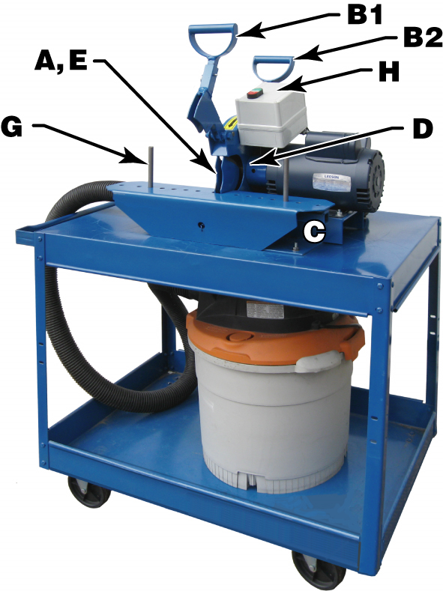
Cutting tool to customize locally
B1 Cutting handle
A,E Cutting Disk
G Adjust hose size pin
C Where to place your hose
H Machine Power on/off
C1 Sediments and fumes container
D Motor
D1 Extraction fan
E1 Portable stand
E1
D1
C1

Slide 5
Cost Analysis

Slide 6
Alternative Manual Cutting Machine
https://www.youtube.com/watch?v=TLlFCBbGhaU
https://www.bccourier.com/global-metal-cutting-tools-market-2019-industry-opportunities-and-development-analysis-2024/

Slide 7
Expected Outcome
Safe workplace for the operators.
Clean environment
Increased cutting speed hence more output.

